Slide 1

Car_On_road
RNS INSTITUTE OF TECHNOLOGY
BENGALURU - 98
DEPARTMENT OF INFORMATION SCIENCE & ENGINEERING
Presentation on Internship
Ronak H Rathod
USN: 1RN19IS406
ENMAZ Engineering Services Pvt. Ltd.
Internal Guide
Dr. Santhosh Kumar
Asst. Prof, Dept of ISE, RNSIT
External Guide
Mr. Akshay D R
Co-Founder, EMMAZ, Bengaluru, Karnataka

Slide 2
AGENDA
Abstract
About the Company
Introduction
Literature Survey
Requirements
System Design
Detailed Design
Implementation
Testing
Conclusion and Future Enhancements
References
Q & A

Slide 3
ABSTRACT
Car_On_road app is an application developed for renting self driving cars and providing information about them.
In recent years, it is difficult to develop applications for both iOS and Android with in less time.
To overcome this, Google introduced a new framework called Flutter.
So with this reactive framework we have developed responsive Flutter application for a user friendly interface for viewing and renting self driving cars
Flutter is highly customizable, which allows it to build apps that are brand-centric, or with the look and feel of native Android and iOS apps from a single code base

Slide 4
About the Company
Enmaz has a simple yet robust solution that helps any Industry / Factory digitise their workfloor in no time. The products offered will help in remote monitoring, controlling and also analysing any machine parameter or process
This company has reliable hardware that its time tested, high quality, designed, developed and manufactured in India with 18 months of replacement warranty.
Innovative software that is easy to use, highly scalable and cloud-based IoT platform.
Dynamic dashboard, Reports, Remote control, Email & SMS alerts.
Their competitive cost is that their cloud hosting starts as low as INR 1299 per month and Hardware prices can compete with best in the industry

Slide 5
INTRODUCTION
Car_On_road app is an application developed for renting self driving cars and providing information about them.
Self-driving vehicles are cars or trucks in which human drivers are never required to take control to safely operate the vehicle. Also known as autonomous or “driverless” cars, they combine sensors and software to control, navigate, and drive the vehicle.
This app facilitates a user to rent and provide information about the self driving cars. Each user can create an account with a username and password.
This allows the users to login into their profile and have access to their account and rent cars and view information on them.
In the existing system, the users don’t have the option to rent self driving cars. Users usually book cars which are driven by drivers manually, where the driver comes to the pick up location and drives you to your location or you can book any car for rent and go pick it up from the agency for example like zoom cars and return it once used.
In order to increase luxury and comfort, the proposed system has been developed. This project has been developed so that a user can easily rent a car a self driving car at the convenience of his house with a trusted company providing rental services and information. The interface is easy to understand user friendly.

Slide 6
LITERATURE SURVEY
Android Studio is an integrated development environment (IDE) for Google Android Operating System. It is built based on JetBrains’ IntelliJ IDEA Community Edition, and it specifically designed for creating applications on Android devices. Some of the key features of Android Studio are as follows:
1. Instant Run – a feature that pushes code and resource changes to the running app. It allows changes to be made to the app without the need to restart the app, or rebuilding the APK, so that the effects can be seen instantly.
2. An Emulator – a virtual android device that can simulate variety of hardware features such as GPS location, network latency, motion sensors, and multi-touch input that can be used to run and install the app. It can then be used for testing purposes.
3. Testing Tools and Frameworks – extensive testing tools such as, JUnit 4 and functional UI test frameworks are included with Android Studio.

Slide 7
Requirements
Hardware Requirements
CPU: Intel i5 8th gen and above
RAM: 8 GB
HDD: 40 GB
Software Requirements
Operating System: Windows 10 and above
Front-end Design: Visual Studio Code / Android Studio Emulator / Chrome
Front-end Language: Dart

Slide 8
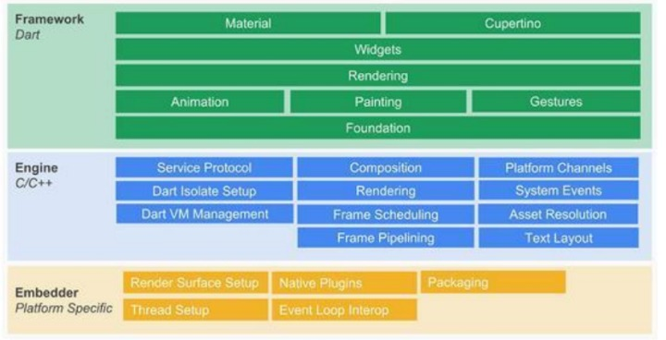
System Design
Architecture
The Flutter framework is organized into a series of layers, with each layer building upon the previous layer.

Slide 9
Continuation of Architecture:
Embedder: Operating system adaptation layer to realize rendering Surface settings, thread settings, etc.
Engine◦: Realize functions such as Flutter rendering engine, text layout, event processing, and Dart runtime. Including Skia graphics drawing library, Dart VM, Text, etc., among which Skia and Text provide the ability to call the underlying rendering and typesetting for the upper layer interface.
Framework: It is a UI SDK implemented with Dart. From top to bottom, it includes two major style component libraries, basic component libraries, graphics drawing, gesture recognition, animation and other functions.

Slide 10
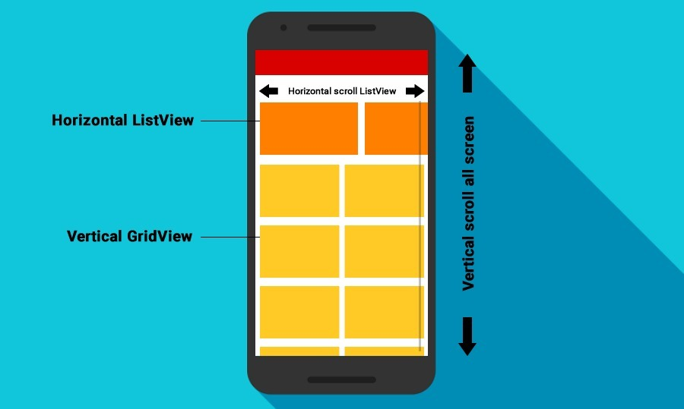
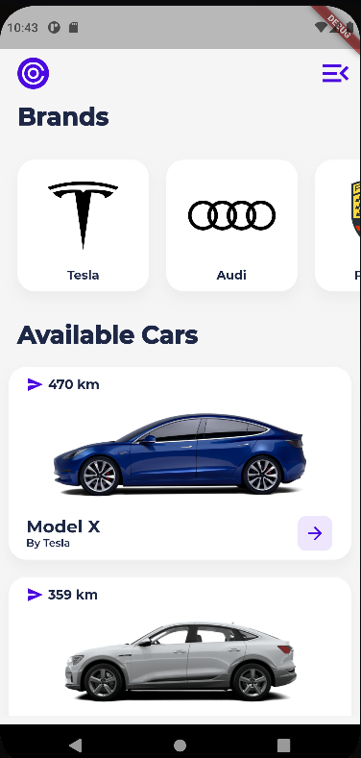
Detailed Design
Design details on Horizontal and Vertical ListView

Slide 11
Detailed Design
Horizontal List View: To scroll a Flutter ListView widget horizontally, set scroll Direction property of the ListView widget to Axis. horizontal. This arranges the items side by side horizontally.
Vertical List View: To scroll a Flutter ListView widget vertically, set scroll Direction property of the ListView widget to Axis. vertical. This arranges the items one below the other vertically.

Slide 12


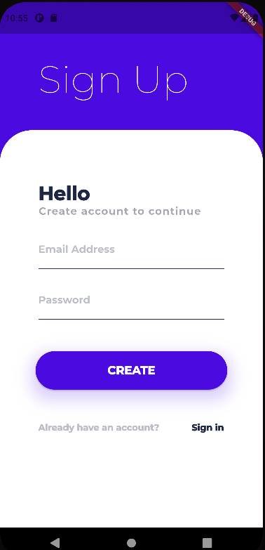
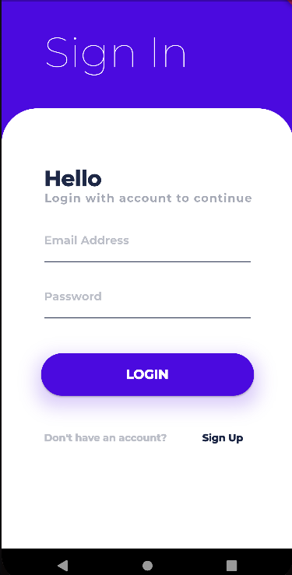
Detailed Design
Design details – Scaffold/Forms/ElevatedButtons
Wireframe design
UI design

Slide 13
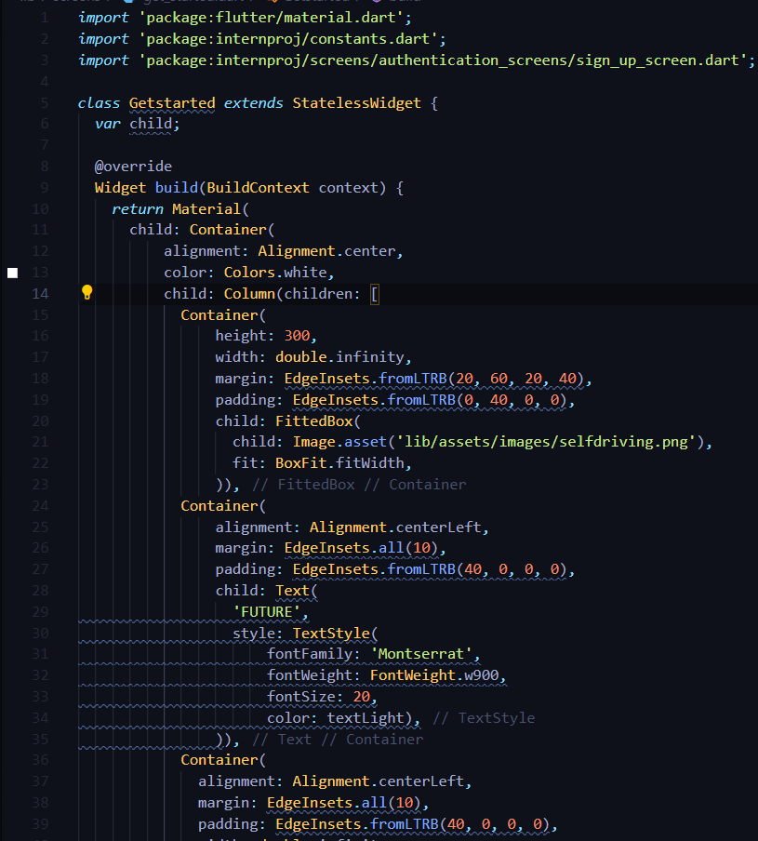
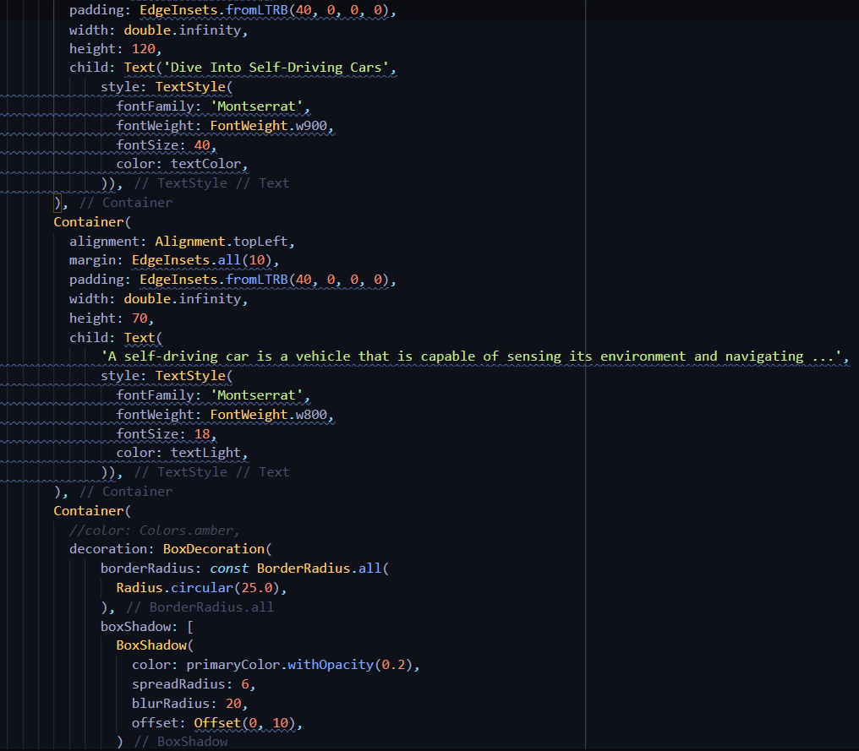
Implementation
Start Screen

Slide 14
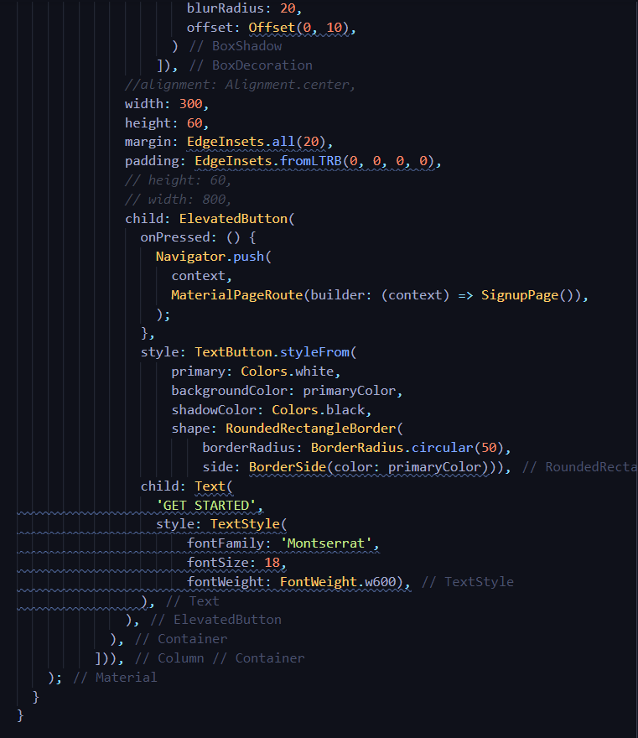
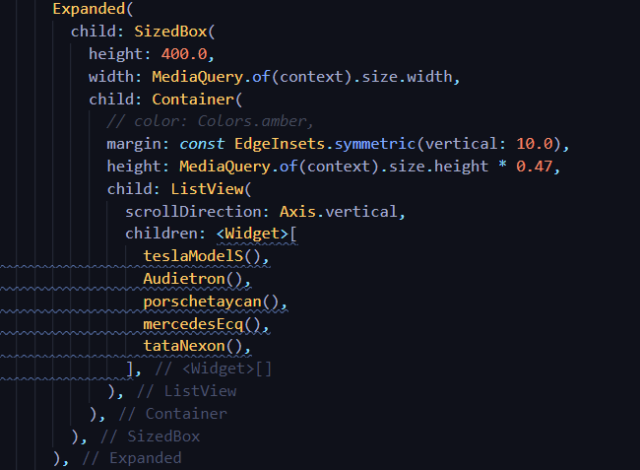
Implementation
Cont. of Start screen Vertical ListView

Slide 15
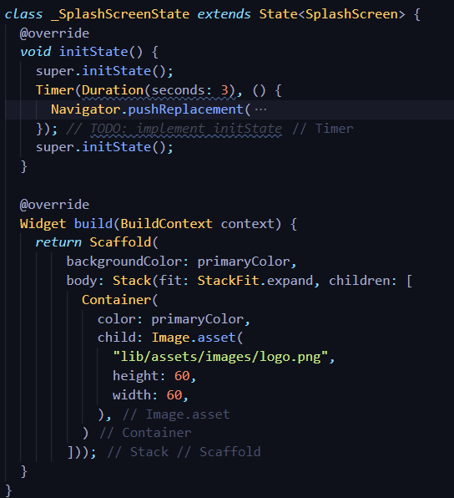
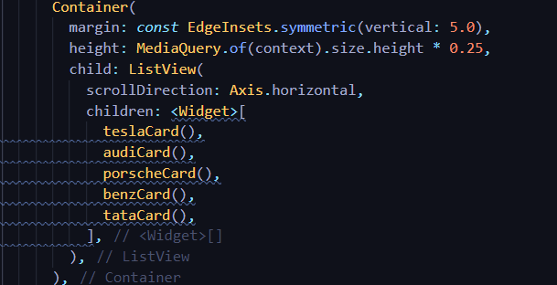
Implementation
Horizontal ListView and Splash screen

Slide 16
CONCLUSIONS
This project was developed to allow users to rent a self driving car and find information on that particular car.
The app allows a user to find the different types of cars available for renting such a Audi, Tesla, Mercedes, etc. It also provides the link to the main website of any given car chosen.
The users hence can create a profile on their own and have access to renting and travelling through these self driven car.
Flutter framework will surely enable a lot of new developers to develop high performance and feature-full mobile application in the near future for applications.

Slide 17
Future Enhancements
A separate set of screens can be developed for users rent the car by entering their details such as pick up location.
A detailed display of the fair of different cars can be shown.
An option for the user to pick what type of initial payment he wants to do.
A confirmation screen to show that the car is on the way along with the location tracker
Security can be added by providing OTP for each ride for safer and secure transportation.

Slide 18
REFERENCES
[1] www.stackoverflow.com
[2] www.w3schools.com
[3] www.github.com
[4] www.codecademy.com
[5] www.geeksforgeeks.org
[6] www.dribble.com
[7] www.medium.com

Slide 19
Question and Answer

Slide 20
THANK YOU

